Slide 1
Fundamentals
SOFTWARE QUALITY ASSURANCE (SQA)

Slide 2
What you will learn Today
Introduction
Shifting our testing to left before the code is written
Learning to analyze the requirements and write tests
Build traceability between requirements and test cases
Explore different testing levels, types and methodologies

Slide 3
Table of Content
Introduction
Requirement and their Validation
Shifting Left
Requirements
Static Testing of Requirements
Requirements as Basis of Test Cases
Mapping and Traceability
Testing Levels
Testing Types
Testing Methodologies in Agile

Slide 4
Requirements and their validation

Slide 5
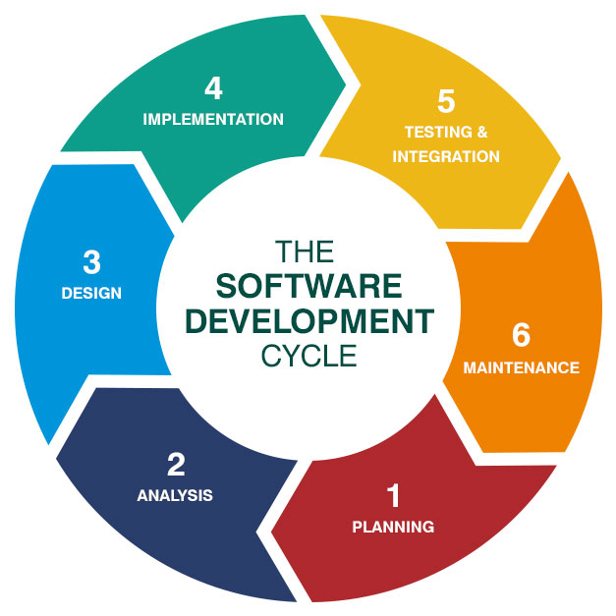
Shifting Left
We have been testing after Impelementation
Is it the right thing to do?

Slide 6
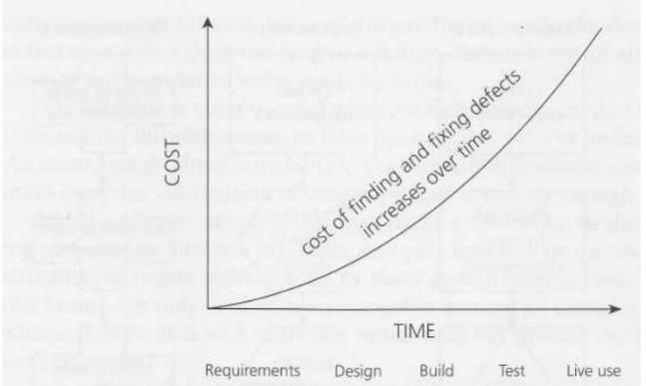
Shifting Left
Cost of finding and fixing bugs after build is high
So We need to Shift left and test early

Slide 7
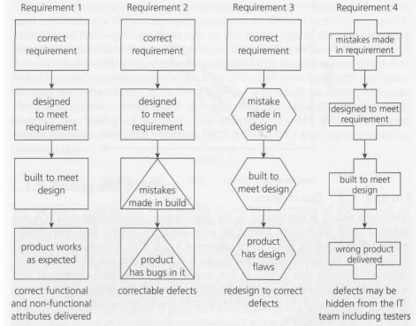
Mistake in requirements may even stay hidden
Requirements Specifications

Slide 8
Requirements specify what the software will become
Requirements Specifications

Slide 9
Requirements Specifications
1. WHO * Who will manage or use the application? – Roles | 2. WHAT * What are the functionalities? - Functions * What is required to achieve results? - Actions * What functionalities will be allowed to WHO? - Permissions * What reports will be generated? - Reports
3. WHEN * When will a certain action be performed or a screen will appear? - Conditions | 4. WHERE * Where can user find xyz functionality to achieve WHAT? - Menus and Screens
5. WHY * Why certain functionalities are not performed, or screens are not accessible or visible? - Restrictions & Limitation | 6. HOW * How to execute any functionality? How to achieve desired result? - Steps
7. THEN In consideration with all the above questions, this stage reveals the desired outcome - Expected Result

Slide 10
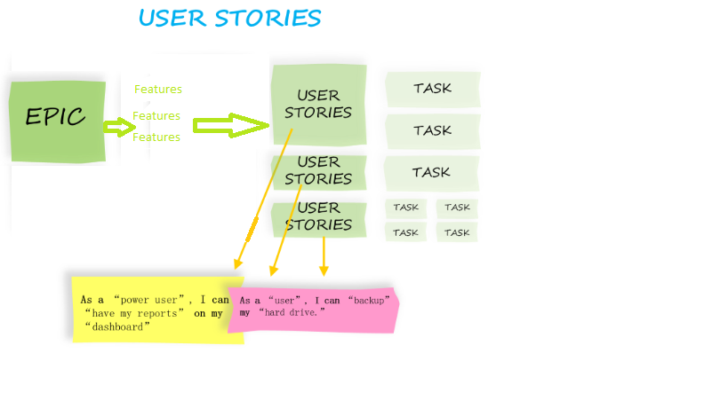
Requirements Specifications
Can come in different forms
Introduction to the Document
1.1 Purpose of the Product
1.2 Scope of the Product
1.3 Acronyms, Abbreviations, Definitions
1.4 References
1.5 Outline of the rest of the SRS
General Description of Product
2.1 Context of Product
2.2 Product Functions
2.3 User Characteristics
2.4 Constraints
2.5 Assumptions and Dependencies
Specific Requirements
3.1 External Interface Requirements
3.1.1 User Interfaces
3.1.2 Hardware Interfaces
3.1.3 Software Interfaces
3.1.4 Communications Interfaces
3.2 Functional Requirements
3.2.1 Class 1
3.2.2 Class 2
…
3.3 Performance Requirements
3.4 Design Constraints
3.5 Quality Requirements
3.6 Other Requirements
Appendices

Slide 11
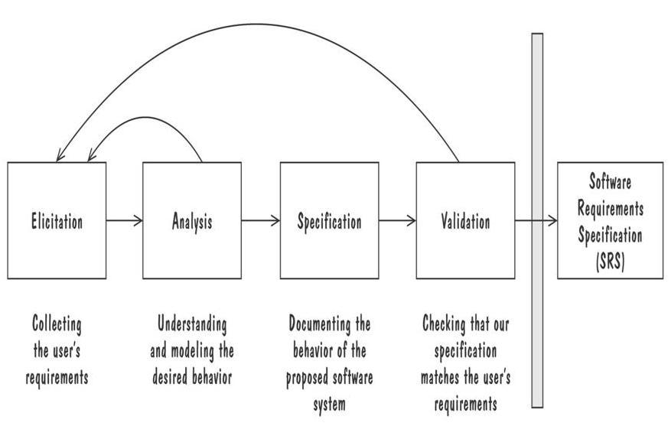
Requirement Process
Creating Software Requirements Specifications

Slide 12
Requirement Elicitation
Requirement Process
Customers do not always understand what their needs and problems are
It is important to discuss the requirements with everyone who has a stake in the system
Different Stakeholders are:
Clients: pay for the software to be developed
Customers: buy the software after it is developed
Users: use the system
Domain experts: familiar with the problem that the software must automate
Market Researchers: conduct surveys to determine future trends and potential customers
Lawyers or auditors: familiar with government, safety, or legal requirements
Software engineers or other technology experts

Slide 13
For testing, you need to understand the perspectives of all stakeholder. Be able to put yourself in their shoes to analyze, design, optimize, and priortize your testing
Requirement Process
Ofcourse, quality is a shared responsibility. So you are not alone. However, the more you can cover and understand the better you will be at your job. The Key is communication and asking questions.

Slide 14
Testing Requirements
Testing Requirements
First review it from a high level to identify large fundamental problems, oversights, and omissions (more like research than testing)
Second perform low-Level specification test
Complete
Accurate
Precise, unambiguous and clear
Consistent
Relevant
Feasible
Testable

Slide 15
Requirements as Test basis

Slide 16
Requirement-Based Testing
Requirement as Test Basis
Requirements specify expected behavior
Test case can be designed based on Requirement Specification document
All requirement documents used to create test cases are called Test Basis
Black-box test design techniques can be applied to cover different aspects of test Coverage
Identify Risk associated with each requirement and apply Risk-based Testing Technique

Slide 17
While Writing Test Cases
Requirement as Test Basis
Identify and map all requirements to all test cases that cover the respective requirement
There can be multiple test cases associated with one requirement.
Identify test coverage of each requirement based on available test cases and target for 100% test coverage of specific requirement
Use test designing to analyze and validate the requirements to identify missing or inconsistent requirements

Slide 18
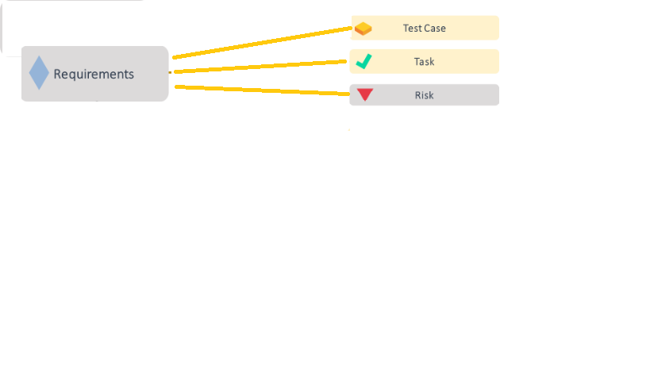
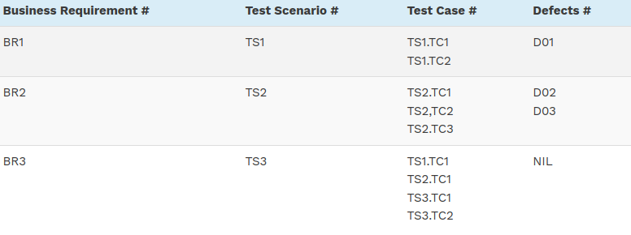
Mapping leads to Traceability
Traceability
Traceability Matrix is a document that correlates any two-baseline documents to check the completeness of the relationship.

Slide 19
Advantages of Requirement Traceability Matrix
Traceability
The build developed and tested has the required functionality which meets the ‘Customers’/ ‘Users’ needs and expectations
It confirms 100% test coverage
It highlights any requirements missing or document inconsistencies
It shows the overall defects or execution status with a focus on business requirements
It helps in analyzing or estimating the impact on the QA team’s work with respect to revisiting or re-working on the test cases

Slide 20
Testing Levels, Types, and Methodologies

Slide 21
Testing Levels
Testing Levels
Unit Testing
focuses on components that are separately testable
Test Basis Examples
Detailed design
Code
Component specifications
Integration Testing
focuses on interactions between components or systems
Test Basis Examples
Software and system design
Interface and communication protocol specifications
Architecture at component or system level
Workflows

Slide 22
Testing Levels
Testing Levels
System Testing
focuses on the behavior and capabilities of a whole system or product, often considering the end-to-end tasks the system can perform and the non-functional behaviors it exhibits while performing those tasks
Objectives
Validate system completeness, Reducing risk, Finding defects, Building confidence
Test Basis Examples
System and software requirement specifications (functional and non-functional)
System and user manuals

Slide 23
Testing Levels
Testing Levels
Acceptance Testing
Acceptance testing may produce information to assess the system’s readiness for deployment and use by the customer (end-user)
Common forms of acceptance testing include the following:
Alpha and beta testing
Alpha and beta testing are typically used by developers of commercial off-the-shelf (COTS) software who want to get feedback from potential or existing users, customers, and/or operators before the software product is put on the market

Slide 24
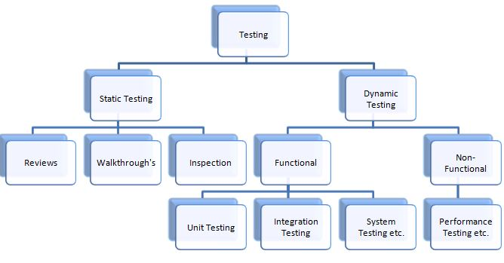
Static and Dynamic Testing
Static & Dynamic Testing
Static Testing – testing a software without running it
Used to test the work products like plan, requirements, architecture and design documents, code, test plan, test cases, user guides, contracts, schedules, budget, etc
Dynamic Testing – running the program
Used to test the working software/system

Slide 25
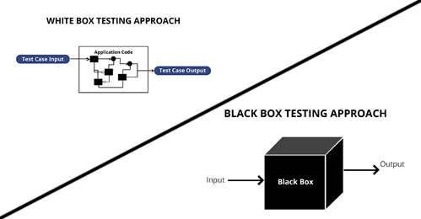
White box and Black box Testing
Testing Types
Black box testing – what is supposed to be done 🡪 functionality
does not concern how the software
accomplish the work
outside view of the software
input-output relationships
White (clear) box testing – how the software does its job
look into code details

Slide 26
Change-related Testing
Testing Types
Confirmation Testing
Testing should be done to confirm that the changes have corrected the defect or implemented the functionality correctly
Regression Testing
Testing should be done to confirm that the changes have not caused any unforeseen adverse consequences

Slide 27
Smoke Test & Sanity Testing
Testing Types
Both testing help avoid wasting time and effort by quickly determining whether an application is too flawed to merit any rigorous testing.
Smoke Test
A test suite that covers the main functionality of a component or system to determine whether it works properly.
Sanity Testing
A test suite that covers the high level testing of new functionality/bug fixes to determine whether it works properly.

Slide 28
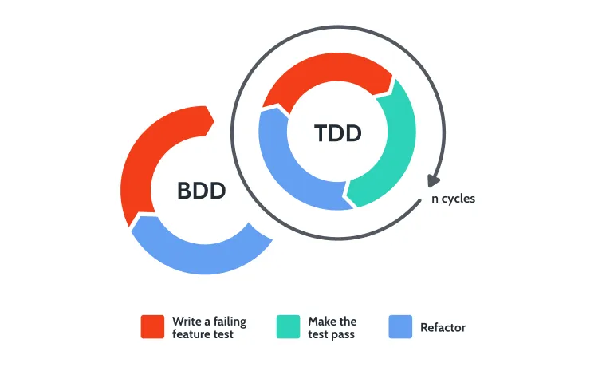
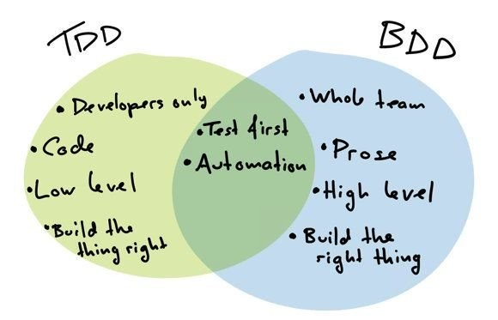
Test First Development Methodologies
Behavior Drive Development and Test Driven Development

Slide 29
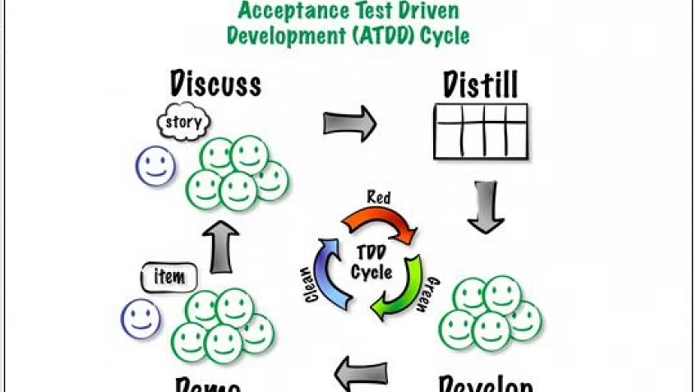
Test First Development Methodologies
Acceptance Test-Driven Development
Defines acceptance criteria and tests during the creation of user stories. ATDD is a technique used WITHIN BDD. They are not one and the same.

Slide 30
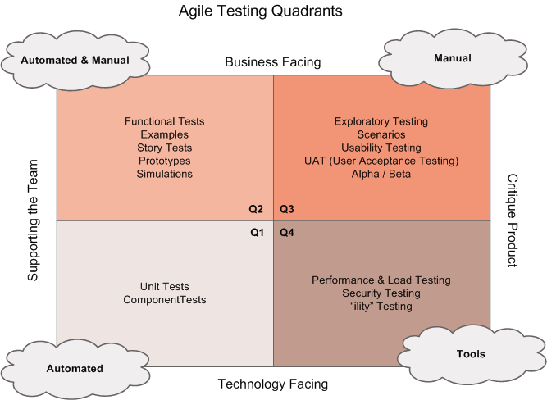
Test First Development Methodologies
Applying testing in Agile

Slide 31
Reading Break and Exercise

Slide 32
Q&A
Instructor Notes

